Slide 1
Observability

Slide 2


Slide 3
Background
Nowadays
Full-Stack Developer for 20+ years
10 In Delphi
15 in ASP.NET MVC
3 in ASP.NET Blazor
Jeff has lead teams in startups and billion dollar businesses
Pioneer in Scrum methodology
Composed music for SimMars mod
Leads DevOps team of 7 members
Responsible for all systems in Enterprise Solutions and many other systems at the University of Winnipeg.
Experiments new technologies on https://LanHUB.net
Mod of reddit.com/r/csharp
Too many hobbies, not enough time

Slide 4

Overview
Services, Applications and Components
Observability
Coverage
Tooling

Slide 5
Business Unit
Definition Trivia!
Major organizational division (e.g., HR, Finance).

Slide 6
Business Unit
Business Capability
Definition Trivia!
What the business does (e.g., Payroll Management).

Slide 7
Business Unit
Business Capability
Service
Definition Trivia!
A value-delivering function (e.g., Payroll Processing Service).

Slide 8
Business Unit
Business Capability
Service
People
Processes
Applications
Definition Trivia!
A software system or program that provides specific functionality to support business processes or services within an organization.

Slide 9
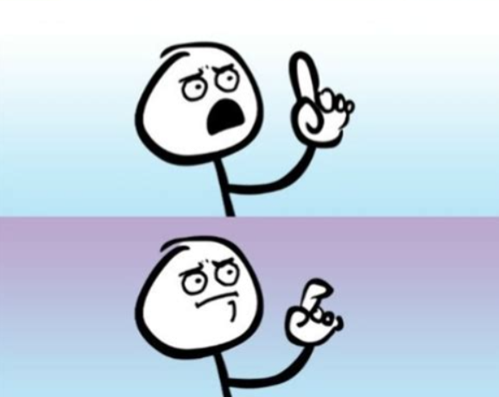
Business Unit
Business Capability
Service
People
Processes
Applications
Components
Definition Trivia!
A modular, self-contained part of an application that fulfills a specific function and interacts with other components to deliver the application's overall capabilities.

Slide 10
Business Unit
Business Capability
Service
People
Processes
Applications
Components
Definition Trivia!
My Responsibility

Slide 11
Component Types
Web Application
Desktop Application
Server
Network
Data Pipeline – Automated
Data Pipeline – Client Initiated
Data Pipeline – Manual
Data Store
Background System
Web Proxy
File Share
Certificate

Slide 12
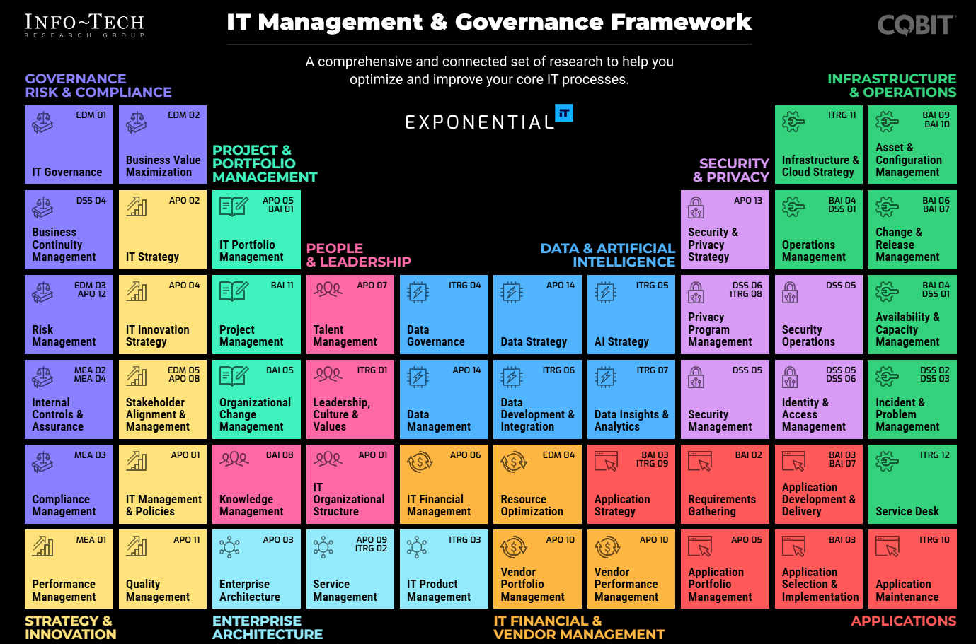

Slide 14
Finance
Accounts Payable
Cheque Importer
Accounts Receivable
Ellucian Recruit
Business Capabilities
Service
(Application)
Business Units
Awards Management
Blackbaud
Context

Slide 15
Cheque Importer
Application
Primary Component
Cheque Importer Web App
Database
Dependency Components
WebServer
Dependency Components 2
DB Server

Slide 16
Application
Primary Component
Blackbaud Cloud
Blackbaud
Student Sync
Dependency Components
Colleague SIS
Dependency Components 2

Slide 17
Application
Primary Component
Recruit Cloud
Colleague SIS
Dependency Components
Ellucian Recruit
Payment Gateway
Dependency Components 2
Colleague SIS
Moneris
Colleague Recruit API

Slide 18
Finance
Accounts Payable
Cheque Importer
Accounts Receivable
Ellucian Recruit
Business Capabilities
Application
Primary Component
Business Units
Awards Management
Cheque Importer Web App
Database
Blackbaud Cloud
Blackbaud
Recruit Cloud
Colleague SIS
Student Sync
Dependency Components
Colleague SIS
WebServer
Payment Gateway
Dependency Components 2
Colleague SIS
Moneris
Colleague Recruit API
DB Server

Slide 19
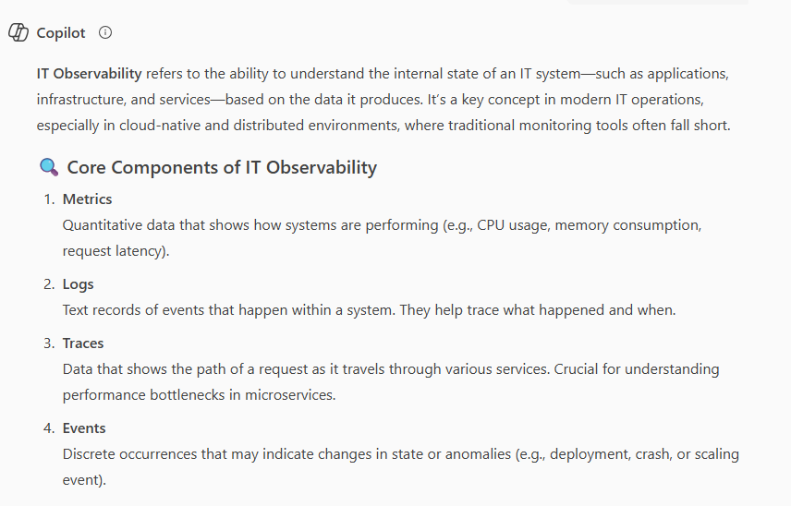
What is Observability

Slide 20
Business Unit
Business Capability
Service
People
Processes
Applications
Components
Definition Trivia!
Most/All “Observability” products

Slide 21
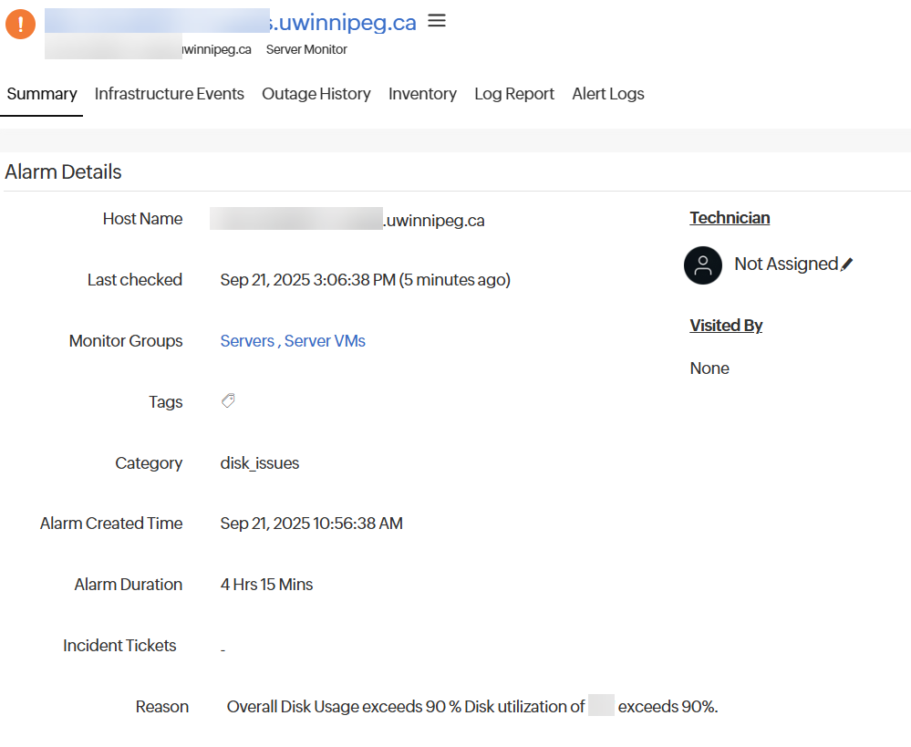


Alert
Business Unit
Business Capability
Service
People
Processes
Applications
Components

Slide 23
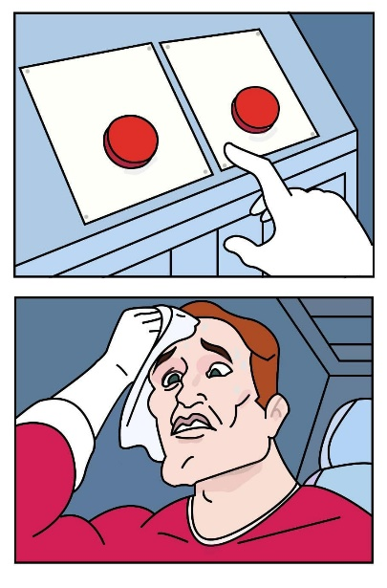
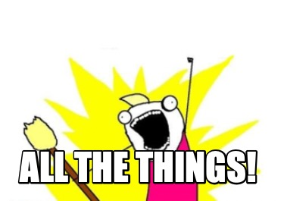
How do we ensure full coverage?
Component-oriented
Bottom-up approach
Off the shelf products
Monitoring everything
Easy to start, hard to complete
Misses the gaps in Services
(Cloud Discovery?)
No Support Model
Service-oriented
Top-Down approach
Creates Documentation
Hard to start, easy to complete
Full Coverage
MVP Monitoring

Slide 24
Service-Oriented Discovery
Finance
Accounts Payable
Cheque Importer
Accounts Receivable
Ellucian Recruit
Business Capabilities
Application
Primary Component
Business Units
Awards Management
Cheque Importer Web App
Database
Blackbaud Cloud
Blackbaud
Recruit Cloud
Colleague SIS
Student Sync
Dependency Components
Colleague SIS
WebServer
Payment Gateway
Dependency Components 2
Colleague SIS
Moneris
Colleague Recruit API
DB Server

Slide 25
Service-Oriented Discovery
Clear line from Component to Business Unit
Auditable
Complete Observability and Impact coverage
No Vendor Tie-in
Identify MVP for
Infrastructure
Support
Exclude components that do not add value to Org
Business Unit
Business Capability
Service
People
Processes
Applications
Components

Slide 26
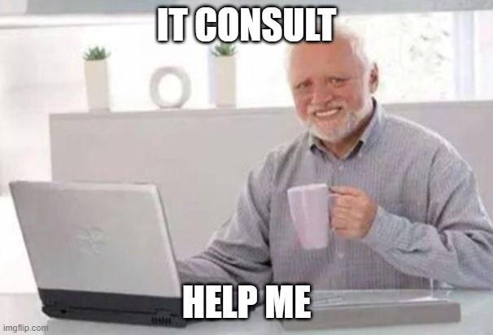
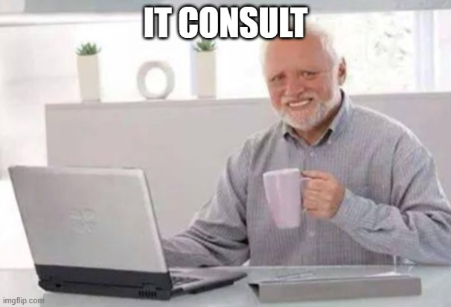
ITSM – Types of Tickets
Service Requests
Incidents
Standard user-initiated requests for access, configuration, or non-disruptive changes.
Examples:
Provisioning new user accounts
Requesting feature toggles or environment access
API key generation or sandbox access
Goal:
Deliver approved services with minimal operational overhead.
Unplanned disruptions or degradations in service affecting production systems.
Examples:
Outage in a core microservice
Performance degradation in a customer-facing portal
Failed deployment or rollback
Goal:
Restore service quickly, minimize impact, and trigger root cause analysis and future prevention.

Slide 27
Impacts

Slide 28
Reality

Slide 29
Demo Time
Notes:
Bring down Server (Desmond’s)
Sharepoint
Business Units
Business Capabilities
Application Inventory
Components
Show Power Automate Flow to create Components
PowerBI
Show Component Map
Show Affected Services
Compass
Component Page
Alerts
Show Desmond’s alert
Assign Component
Jira
Create work ticket

Slide 30
Realization
Not a one-many relationship
Many to one relationships
One to Many relationships
Many to Many relationships

Slide 31
Table Structure

Slide 32
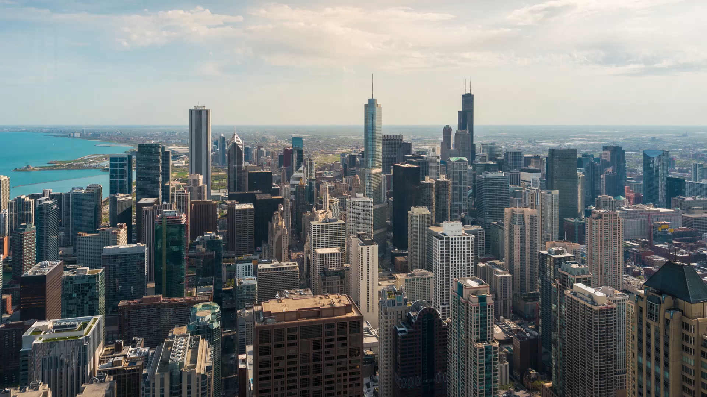
Takeaways
(Take a Picture)
Github with Table Structures
https://github.com/thestamp/PrairieDevCon
COBIT – Grid
https://www.infotech.com/browse/management-and-governance
COBIT - Application Portfolio
https://www.infotech.com/research/ss/rationalize-your-application-portfolio#unlock-modal
Book - Minimum Viable Enterprise Architecture
https://www.amazon.ca/Minimum-Enterprise-Architecture-Business-Digital-ebook/dp/B0BQMQD6Q7/

Slide 33
Thank you!
Any Questions?

